Slide 1

Small Business
Counter-Intelligence ⫘ Insider Threat Program
Will McEllen, SFPC
Facility Security Officer
Primal Innovation, LLC

Slide 2
“CI that is passive and defensive will fail.”
̶ James M. Olson
Former Chief of Counterintelligence, CIA

Slide 3
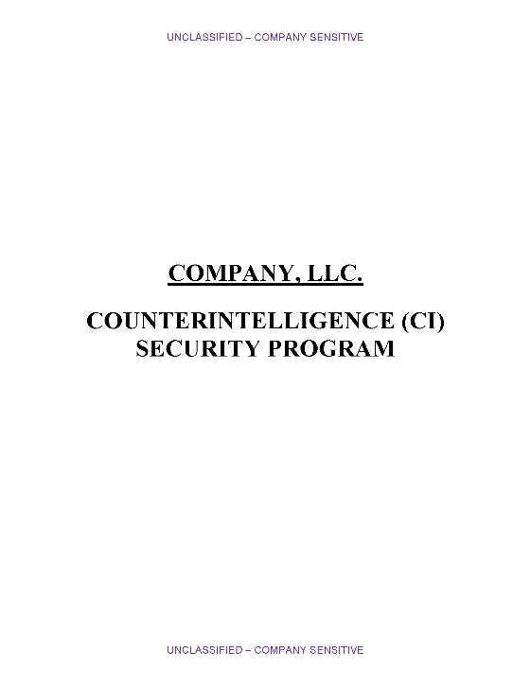
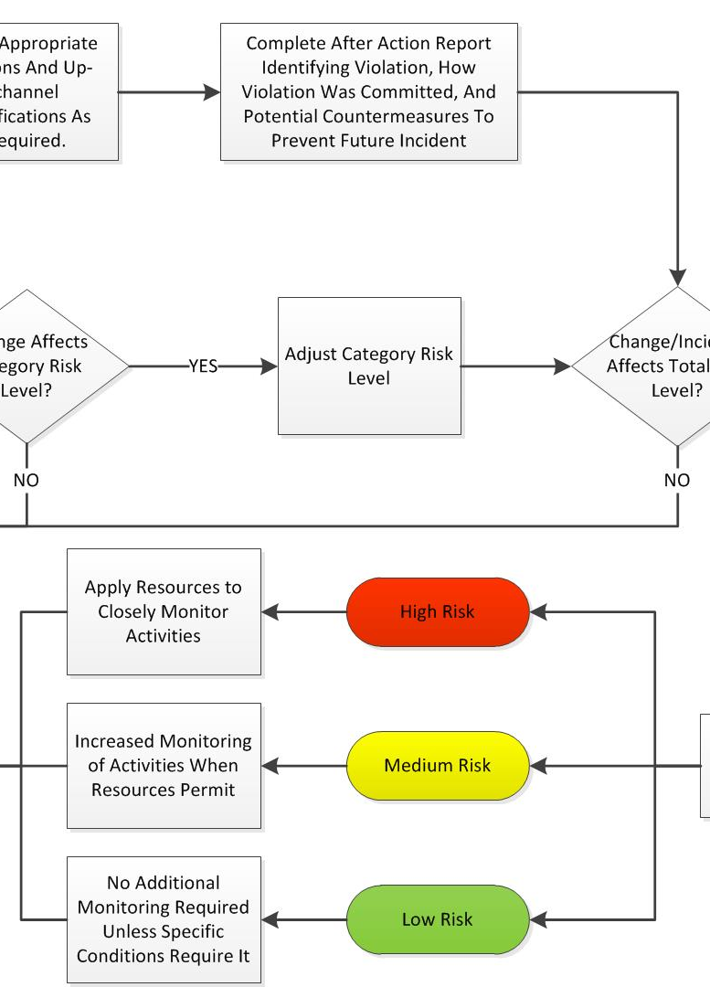
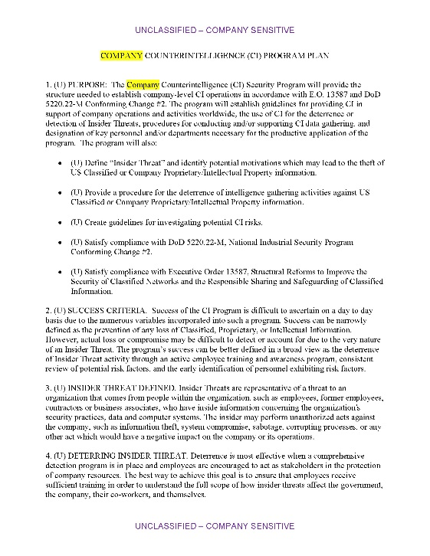
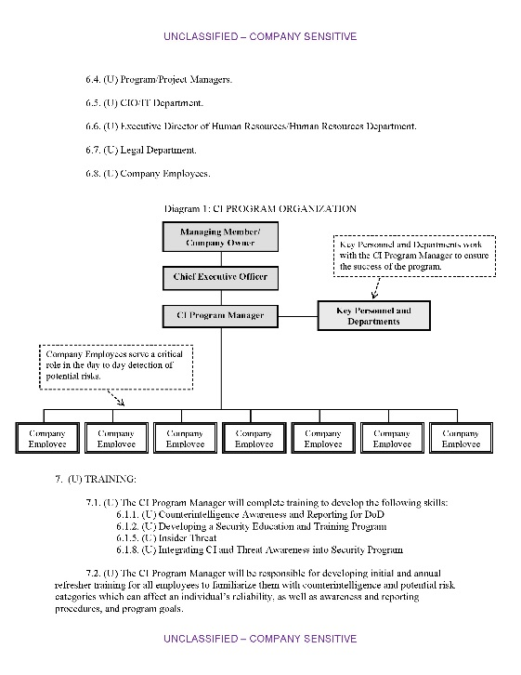
Program Components
Program Plan
Tracking System
Flowchart

Slide 4
CI/IT Program Plan
SUCCESS CRITERIA. Success of the Program is difficult to ascertain on a day to day basis due to the numerous variables incorporated into such a program. Success can be narrowly defined as the prevention of any loss of Classified, Proprietary, or Intellectual Information. However, actual loss or compromise may be difficult to detect or account for due to the very nature of an Insider Threat. The program’s success can be better defined in a broad view as the deterrence of Insider Threat activity through an active employee training and awareness program, consistent review of potential risk factors, and the early identification of personnel exhibiting risk factors.
⇛
Identify potential risks through the use of open sources, such as social media and legal databases, as well as verifiable information submitted by co-workers, supervisors, and managers.
⇛
Assign priorities for the focusing of company resources towards the greatest potential threats.
⇛
Assist personnel with methods or resources that can reduce their risk potential or exposure.

Slide 5
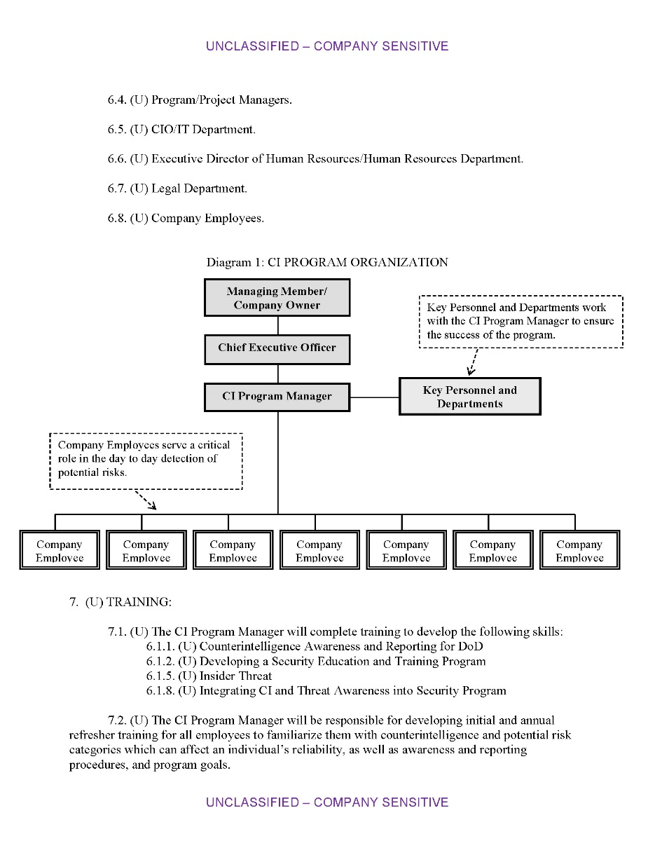
CI/IT Program Plan
⇛
Explains the goals and reasons for the program.
⇛
Establishes responsibilities within the program.
⇛
Identifies potential risk areas as well as tools which can be utilized to counter those risks.

Slide 6
Tracking System
Personal
Professional
Targeting Risk
Money
Ego
Performance
Foreign Travel
Ideology
Nationalism
Violations
Exposure
Conscience
Sexual Activity or Behavior
Personal Connections

Slide 7
Category | Level | Guideline
Money | 0 | No issues identified or any issues are effectively mitigated
 | 1 | Minimal issues, concerns, or more serious issues are partially mitigated
 | 2
 | 3
 | 4 | Issues or concerns commensurate with current economic standings
 | 5
 | 6
 | 7 | Above average issues in excess of current economic standings
 | 8
 | 9
 | 10 | Serious issues, debts, foreclosures or extravagant activities far beyond current economic standing
Category | Level | Guideline
Ideology | 0 | No issues identified or any issues are effectively mitigated
 | 1 | Individual expresses some interest in political, religious, or personal beliefs
 | 2
 | 3
 | 4 | Individual has strong political, religious, or personal beliefs which may be contrary to US policies or activites. The force behind these beliefs is commensurate with, or slightly above, current societal standards
 | 5
 | 6
 | 7 | Individual has very strong political, religious, or personal beliefs which may be contrary to US policies or activities and has expressed that these beliefs are above other societal restrictions
 | 8
 | 9
 | 10 | Has extreme political, religious, or personal beliefs above societal restrictions and actively works to promote or carry out these beliefs

Slide 8
Category | Level | Guideline
Conscience | 0 | No issues identified or any issues are effectively mitigated
 | 1 | Has minor ethical or moral concerns regarding company activities or products. Alternatively, if working on US contracts, the individual demonstrates minor ethical or moral concerns regarding US policies or activities
 | 2
 | 3
 | 4 | Has ethical or moral concerns regarding company activities or products. Alternatively, if working on US contracts, the individual demonstrates ethical or moral concerns regarding US policies or activities
 | 5
 | 6
 | 7 | Expresses strong ethical or moral concerns regarding company activities or products. Alternatively, if working on US contracts, the individual expresses strong ethical or moral concerns regarding US policies or activities
 | 8
 | 9
 | 10 | Consistently makes extreme expressions, or demonstrates against, company products or US policies or activities
Category | Level | Guideline
Ego | 0 | No issues identified or any issues are effectively mitigated
 | 1 | Minimal issues, or more serious issues are partially mitigated
 | 2
 | 3
 | 4 | Individual has an above average feeling of self-importance and may feel slighted under normal circumstances
 | 5
 | 6
 | 7 | Individual feels that they lack importance, feels that they have been treated unfairly, or feels that they have been wronged (either real or imagined)
 | 8
 | 9
 | 10 | Consistently expresses or displays a belief that they are superior and/or that their importance is rarely, if ever, recognized

Slide 9
Category | Level | Guideline
Nationalism | 0 | No issues identified or any issues are effectively mitigated
 | 1 | Has ties to a foreign country either due to dual-citizenship, family relations, foreign friends, or presents some other connection to a foreign country
 | 2
 | 3
 | 4 | Expresses feelings of connection with a foreign country or government equivalent to their connection with the US
 | 5
 | 6
 | 7 | Makes repeated verbal, written, or implied statements identifying a desire to aid a foreign country or government
 | 8
 | 9
 | 10 | Expresses great regard for foreign country or government and demonstrates a strong desire or intent to help the foreign country
Category | Level | Guideline
Sexual Activity/Behavior | 0 | No issues identified or any issues are effectively mitigated
 | 1 | Minor issues due to natural age or maturity, or more serious issues are partially mitigated
 | 2
 | 3
 | 4 | Potential issues due to personal proclivities for non-traditional activities and potential for manipulation
 | 5
 | 6
 | 7 | High risk due to hidden lifestyle or potential for manipulation or coercion
 | 8
 | 9
 | 10 | Very high risk of being manipulated or coerced due to sexual activities or behavior

Slide 10
Category | Level | Guideline
Personal Connections | 0 | No issues identified or any issues are effectively mitigated
 | 1 | Has friendship ties to individual(s) working at competing companies
 | 2
 | 3
 | 4 | Has personal ties to individual(s) working at competing companies. These ties exceed basic friendship and may be associated with shared history, goals, or needs
 | 5
 | 6
 | 7 | Has very strong ties to individual(s) working at competing companies. These ties are likely emotional in nature and may be associated with a long term relationship
 | 8
 | 9
 | 10 | Extreme ties of obligation or connection to individual(s) working at competing companies

Slide 11
Category | Level | Guideline
Work Performance | 0 | No issues identified or any issues are effectively mitigated
 | 1 | Minimal issues, concerns, or more serious issues are partially mitigated
 | 2
 | 3
 | 4 | Some issues or concerns
 | 5
 | 6
 | 7 | Above average issues that have the potential to require termination
 | 8
 | 9
 | 10 | Serious issues which could result in immediate termination
Category | Level | Guideline
Work Violations | 0 | No issues identified or any issues are effectively mitigated
 | 1 | Minimal issues, concerns, or more serious issues are partially mitigated
 | 2
 | 3
 | 4 | Some issues or concerns
 | 5
 | 6
 | 7 | Above average issues that have the potential to require termination
 | 8
 | 9
 | 10 | Serious issues which could result in immediate termination

Slide 12
Tracking System
Personal |  |  |  |  |  |  | Work |  | Calculated Total | Risk Potential
Money | Ideology | Conscience | Ego | Nationalism | Sexual Behavior | Personal Connections | Performance | Violations
1 | 2 | 0 | 4 | 2 | 6 | 2 | 4 | 8 | 880 | High
2 | 1 | 3 | 4 | 2 | 1 | 0 | 3 | 3 | 210 | Low
3 | 6 | 5 | 1 | 2 | 2 | 3 | 3 | 2 | 455 | Medium
2 | 3 | 4 | 1 | 2 | 0 | 0 | 1 | 1 | 145 | Low
Individual Category Ratings
Rating | Level | Calculated
Negligible | 0 | 0
Low | 1 | 5
 | 2 | 15
 | 3 | 35
Medium | 4 | 65
 | 5 | 100
 | 6 | 200
High | 7 | 350
 | 8 | 500
 | 9 | 700
Very High | 10 | 1000
Calculated Risk Rating
Rating | Calculated Range
Negligible | 0-0
Low | 1-300
Medium | 301-600
High | 601-999
Very High | 1000+

Slide 13
Type | Level | Guideline
Foreign Travel | 0 | Individual does not travel outside of local area
 | 1 | Individual rarely travels outside the local area or the country
 | 2 | Individual occasionally travels outside the country for work or tourism
 | 3 | Individual's position requires frequent overseas travel or they routinely travel outside the country for tourism or personal reasons.
 | 4 | Individual makes constant overseas trips with multiple return trips to the same locations/regions
Type | Level | Guideline
Exposure | 0 | No connection has been identified linking individual to classified or proprietary projects
 | 1 | There is only insubstantial info which potentially links individual to classified or proprietary projects
 | 2 | There is circumstantial data which could link the individual to classified or proprietary projects
 | 3 | Individual makes some reference to work on classified or proprietary projects through conversation and/or web based sites
 | 4 | Individual openly reveals connection to classified or proprietary projects through conversation and/or web based sites

Slide 14
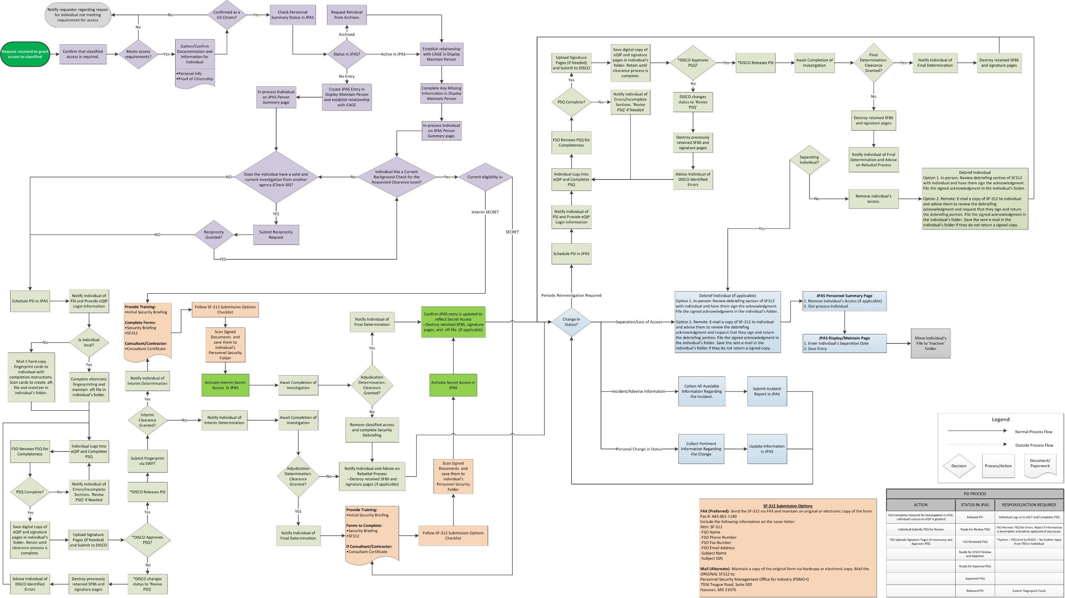
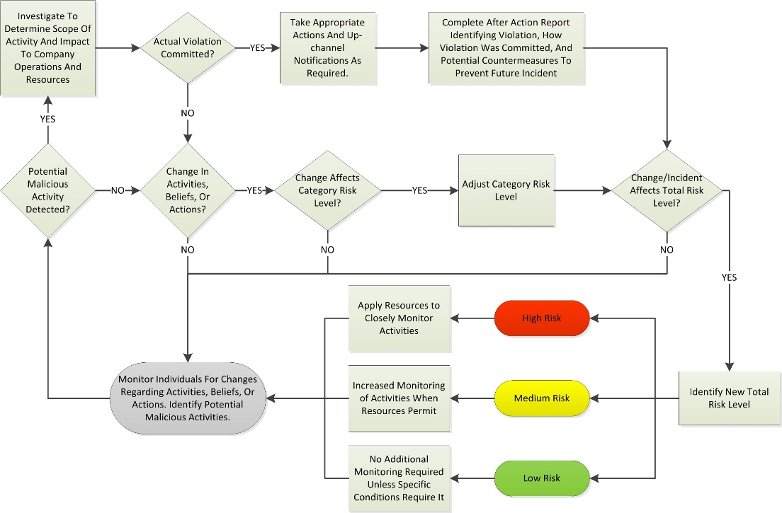

Slide 15

Flowchart

Slide 16
Gathering the Data
 | Human Resources | Information Technology | Project Managers / Supervisors | Co-workers | Travel Coordinator | Open Source Checks
Money | ∎ |  |  | ∎ |  | ∎
Ideology |  |  | ∎ | ∎ |  | ∎
Conscience |  |  | ∎ | ∎ |  | ∎
Ego | ∎ |  | ∎ | ∎ |  | ∎
Nationalism |  |  | ∎ | ∎ |  | ∎
Sexual Activity/Behavior |  |  | ∎ | ∎ |  | ∎
Personal Connections |  |  |  |  |  | ∎
Performance | ∎ |  | ∎ | ∎
Violations | ∎ | ∎ | ∎
Foreign Travel | ∎ | ∎ | ∎ | ∎ | ∎ | ∎
Exposure |  |  |  |  |  | ∎

Slide 17

Gathering the Data – Open Source Information
PLEASE NOTE!
⇛
Please discuss any open source gathering with your company’s Human Resources and Legal departments before you start.
⇛
For this presentation, open source is identified as information that is available and can be viewed without the use of any logons or passwords.
⇛
The laws and public perception regarding personal open source data is constantly shifting so it is essential that you stay abreast of any changes.

Slide 18
Gathering the Data – Open Source Information
Social Media
Social Media
Facebook | URL | LinkedIn | URL | Academia | URL | Flickr | URL | Twitter | URL | Foursquare | URL | Fetlife | URL | Tumblr | URL | Other1 | Other2 | Other3
1 | www. | 1 | www. |  |  |  |  | 2 | www. |  |  |  |  | 1 | www.
3 | www. |  |  |  |  | 3 | www. | * | www.
 |  | 2 | www. | 0 | www. |  |  |  |  |  |  | 1 | www. |  |  | www.catfancy
* | www.
⇛
Individuals may repeat screen names across multiple sites.
Social Media
Blank | Indicates no account or no known account
#/Name | Numerical entry indicates level of use (Levels 0-4)/Indicates screen name.
0 | Account with minimal level of use
1 | Account with some use (Monthly)
2 | Account with average use (Weekly)
3 | Account with above average use (Daily)
4 | Account with excessive use (Hourly)
* | Account locked or not accessible
⇛
Keeping a list of URLs allows you to easily return to sites at a later date in order to track status changes.
⇛
Searching multiple engines (Google, Yahoo, Bing, etc.) will often yield additional results based on screen names and e-mail addresses.

Slide 19
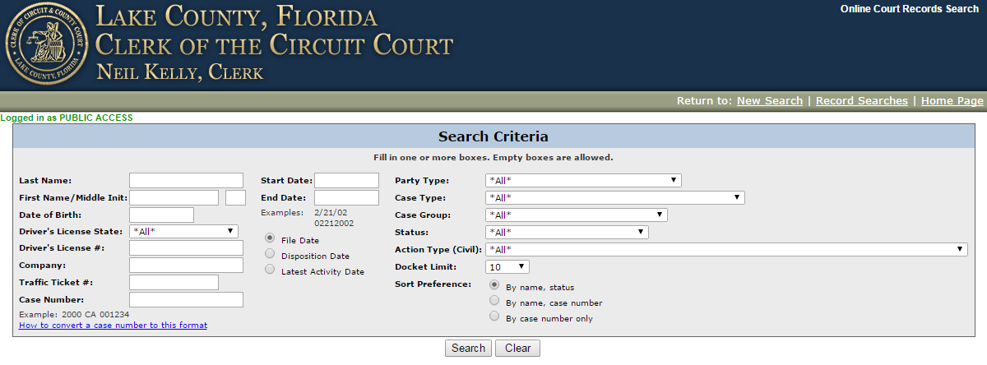
Gathering the Data – Open Source Information
Local, State, and Federal Databases
County Clerk Records
Volusia | http://app02.clerk.org/cr_inq/
Seminole | http://www.seminoleclerk.org/CriminalDocket/
Orange | http://myclerk.myorangeclerk.com/default.aspx
Osceola | https://online.osceolaclerk.org/BenchmarkWeb/Home.aspx/Search
Marion | http://casesearch.marioncountyclerk.org/
Lake | http://www.lakecountyclerk.org/record_searches/online_court_records/online_court_records.asp?

Slide 20
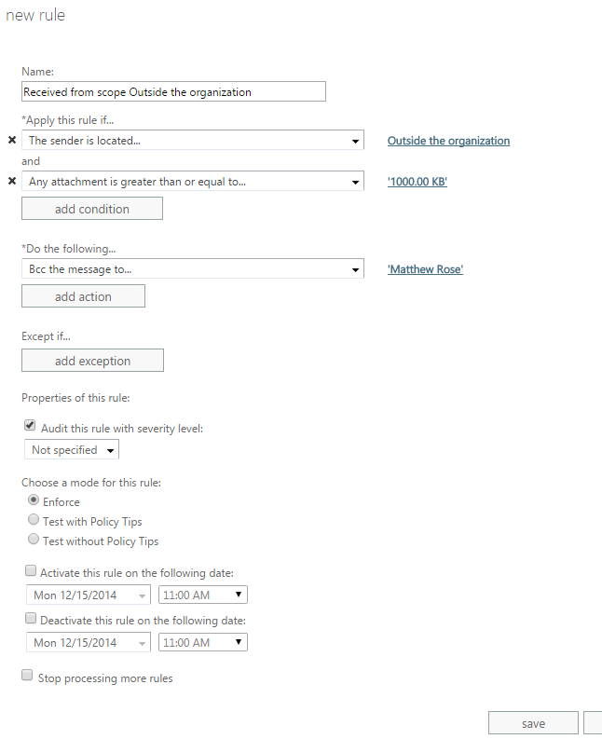
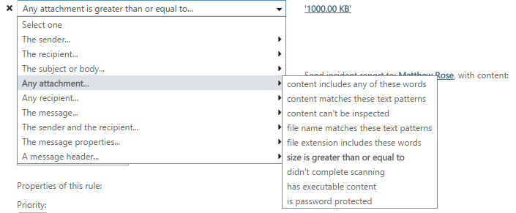
Gathering the Data – Company Internal Tracking
⇛
Microsoft Outlook can be configured to provide useful reports regarding abnormal activities.
⇛
This helps track sudden increases in data traffic which could be indicative of possible misuse or misappropriation.
⇛
Additional options allow for the tracking of communications to specific domains or the utilization of specific keywords.

Slide 21
Questions?

